Slide 1
Chapter 5
Input/Output
Tanenbaum, Modern Operating Systems 3 e, (c) 2008 Prentice-Hall, Inc. All rights reserved. 0-13-6006639

Slide 2
Overview
OS controls I/O devices =>
  Issue commands,
  handles interrupts,
  handles errors
Provide easy to use interface to devices
  Hopefully device independent
First look at hardware, then software
  Emphasize software
  Software structured in layers
  Look at disks
Tanenbaum, Modern Operating Systems 3 e, (c) 2008 Prentice-Hall, Inc. All rights reserved. 0-13-6006639

Slide 3
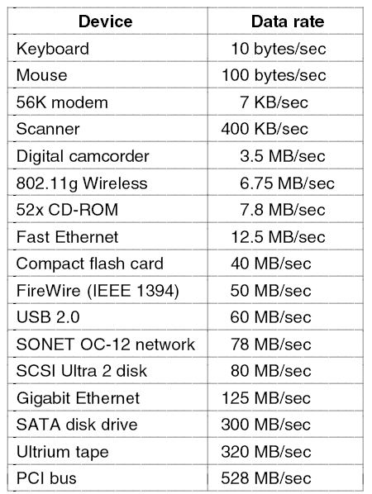
I/O Devices
Some typical device network, and bus data rates.
Tanenbaum, Modern Operating Systems 3 e, (c) 2008 Prentice-Hall, Inc. All rights reserved. 0-13-6006639

Slide 4
Overview
Two types of I/O devices- block, character
Block- can read blocks independently of one another
  Hard disks, CD-ROMs, USB sticks
  512-32,768 bytes
Character-accepts characters without regard to block structure
  Printers, mice, network interfaces
Not everything fits, e.g. clocks don’t fit
Division allows for OS to deal with devices in device independent manner
  File system deals with blocks
Tanenbaum, Modern Operating Systems 3 e, (c) 2008 Prentice-Hall, Inc. All rights reserved. 0-13-6006639

Slide 5
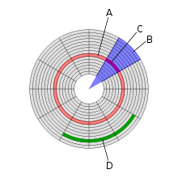
Disk geometry
A is track, B is sector, C is geometrical sector, D is cluster
Tanenbaum, Modern Operating Systems 3 e, (c) 2008 Prentice-Hall, Inc. All rights reserved. 0-13-6006639

Slide 6
Device Controllers
I/O unit has 2 components-mechanical, electronic (controller)
Controller is a chip with a connector which
plugs into cables to device
Disk
  Disk might have 10,000 sectors of 512 bytes per track
  Serial bit stream comes off drive
  Has preamble, 4096 bits/sector, error correcting code
  Preamble has sector number, cylinder number, sector size….
Tanenbaum, Modern Operating Systems 3 e, (c) 2008 Prentice-Hall, Inc. All rights reserved. 0-13-6006639

Slide 7
Device Controllers
Controller assembles block from bit stream, does error correction, puts into buffer in controller
Blocks are what are sent from a disk
Tanenbaum, Modern Operating Systems 3 e, (c) 2008 Prentice-Hall, Inc. All rights reserved. 0-13-6006639

Slide 8
Memory Mapped I/O
Controller has registers which OS can write and read
Write - gives command to device
Read - learn device status……
Devices have data buffer which OS can read/write (e.g. video RAM, used to display pixels on a screen)
How does CPU communicate with registers and buffers?
Tanenbaum, Modern Operating Systems 3 e, (c) 2008 Prentice-Hall, Inc. All rights reserved. 0-13-6006639

Slide 9
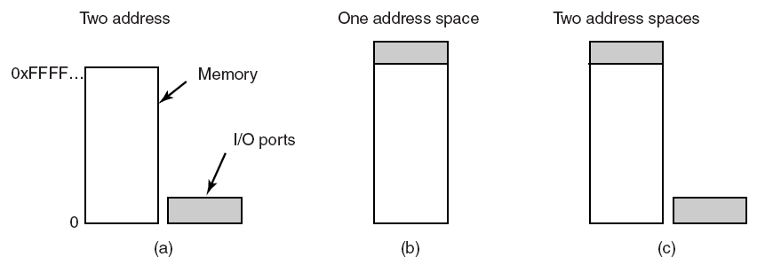
Memory-Mapped I/O
(a) Separate I/O ports and memory space.
(b) Memory-mapped I/O. (c) Memory mapped data buffers and separate ports (Pentium)
Tanenbaum, Modern Operating Systems 3 e, (c) 2008 Prentice-Hall, Inc. All rights reserved. 0-13-6006639

Slide 10
How CPU addresses registers and buffers
First scheme
  Puts read on control line
  Put address on address line
  Puts I/O space or memory space on signal line to differentiate
  Read from memory or I/O space
Memory mapped approach
  Put address on address line and let memory and I/O devices compare address with the ranges they serve
Tanenbaum, Modern Operating Systems 3 e, (c) 2008 Prentice-Hall, Inc. All rights reserved. 0-13-6006639

Slide 11
Memory mapped advantages
Don’t need special instructions to read/write control registers=> can write a device driver in C
Don’t need special protection to keep users from doing I/O directly. Just don’t put I/O memory in any user space
Tanenbaum, Modern Operating Systems 3 e, (c) 2008 Prentice-Hall, Inc. All rights reserved. 0-13-6006639

Slide 12
Memory mapped advantages
An instruction can reference control registers and memory
Loop test port_4 //check if port 4 is zero
beq ready //it is is zero, go to ready
branch loop //otherwise, continue testing
Ready
If instruction just references registers, then need more instructions to do the test-read it in, test it……
Tanenbaum, Modern Operating Systems 3 e, (c) 2008 Prentice-Hall, Inc. All rights reserved. 0-13-6006639

Slide 13
Memory mapped disadvantage
Can cache memory words, which means that old memory value (e.g. for port 4) could remain in cache
=> have to be able to disable caching when it is worthwhile
I/O devices and memory have to respond to memory references
Works with single bus because both memory and I/O look at address on bus and decide who it is for
harder with multiple buses
Tanenbaum, Modern Operating Systems 3 e, (c) 2008 Prentice-Hall, Inc. All rights reserved. 0-13-6006639

Slide 14
Memory mapped disadvantage
I/O devices and memory have to respond to memory references
Works with single bus because both memory and I/O look at address on bus and decide who it is for
harder with multiple buses
Tanenbaum, Modern Operating Systems 3 e, (c) 2008 Prentice-Hall, Inc. All rights reserved. 0-13-6006639

Slide 15
Memory mapped disadvantage
Works with single bus because both memory and I/O look at address and decide who it is for
Harder with multiple buses because I/O devices can’t see their addresses go by any more
Tanenbaum, Modern Operating Systems 3 e, (c) 2008 Prentice-Hall, Inc. All rights reserved. 0-13-6006639

Slide 16
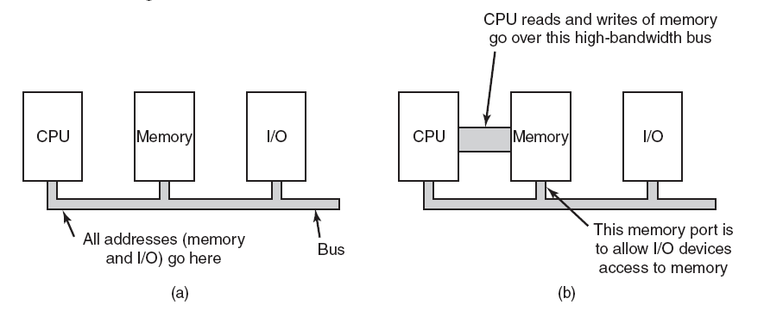
Memory-Mapped I/O
(a) A single-bus architecture.
(b) A dual-bus memory architecture.
Tanenbaum, Modern Operating Systems 3 e, (c) 2008 Prentice-Hall, Inc. All rights reserved. 0-13-6006639

Slide 17
Solutions
Solution is for CPU to try memory first. If it does not get a response then it tries I/O device
Other fixes-snooping device, filter addresses
Main point-have to complicate hardware to make this work
Tanenbaum, Modern Operating Systems 3 e, (c) 2008 Prentice-Hall, Inc. All rights reserved. 0-13-6006639

Slide 18
DMA
CPU COULD request data one byte at a time from I/O controller
Big waste of time, use DMA
DMA controller on mother-board; normally one controller for multiple devices
CPU reads/writes to registers in controller
  Memory address register
  Byte count register
  Control registers-I/O port, direction of transfer, transfer units (byte/word), number of bytes to transfer in a burst
Tanenbaum, Modern Operating Systems 3 e, (c) 2008 Prentice-Hall, Inc. All rights reserved. 0-13-6006639

Slide 19
When DMA is not used
Controller reads a block into its memory
Computes checksum
Interrupts OS
Sends byte at a time to memory
Tanenbaum, Modern Operating Systems 3 e, (c) 2008 Prentice-Hall, Inc. All rights reserved. 0-13-6006639

Slide 20
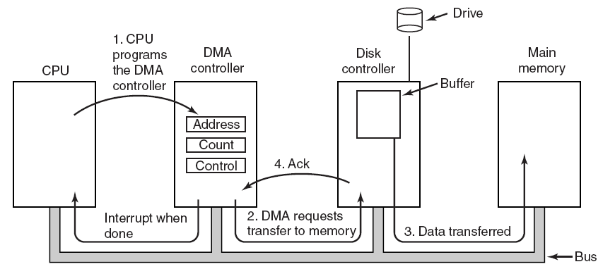
How does DMA work?
Operation of a DMA transfer.
Tanenbaum, Modern Operating Systems 3 e, (c) 2008 Prentice-Hall, Inc. All rights reserved. 0-13-6006639

Slide 21
DMA controller modes
Cycle stealing mode-transfer goes on word at a time, competing with CPU for bus cycles. Idea is that CPU loses the occasional cycle to the DMA controller
Burst mode-DMA controller grabs bus and sends a block
Fly by mode-DMA controller tells device controller to send word to it instead of memory. Can be used to transfer data between devices.
Tanenbaum, Modern Operating Systems 3 e, (c) 2008 Prentice-Hall, Inc. All rights reserved. 0-13-6006639

Slide 22
Questions
Why buffer data in controllers?
  Can do check-sum
  Bus may be busy-need to store data someplace
Is DMA really worth it? Not if
  CPU is much faster then DMA controller and can do the job faster
  don’t have too much data to transfer
Tanenbaum, Modern Operating Systems 3 e, (c) 2008 Prentice-Hall, Inc. All rights reserved. 0-13-6006639

Slide 23
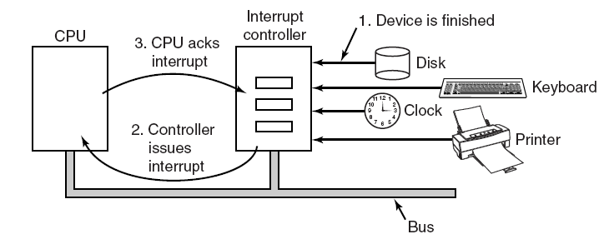
PC interrupt structure
The connections between the devices and the interrupt controller use interrupt lines on the bus rather than dedicated wires.
Tanenbaum, Modern Operating Systems 3 e, (c) 2008 Prentice-Hall, Inc. All rights reserved. 0-13-6006639

Slide 24
Interrupt processing
Controller puts number on address line telling CPU which device wants attention and interrupts CPU
Table (interrupt vector) points to interrupt service routine
Number on address line acts as index into interrupt vector
Interrupt vector contains PC which points to start of service routine
Tanenbaum, Modern Operating Systems 3 e, (c) 2008 Prentice-Hall, Inc. All rights reserved. 0-13-6006639

Slide 25
Interrupt processing
Interrupt service routine acks interrupt
Saves information about interrupted program
Where to save information
  User process stack, kernel stack are both possibilities
  Both have problems
Tanenbaum, Modern Operating Systems 3 e, (c) 2008 Prentice-Hall, Inc. All rights reserved. 0-13-6006639

Slide 26
Can we save the PC and PSW?
Sure, if we don’t use pipelined or superscaler CPU’s. But we do use them.
Can’t assume that all instructions up to and including given instruction have been executed
  Pipeline-bunch of instructions are partially completed
  Superscaler-instructions are decomposed and can execute out of order
Tanenbaum, Modern Operating Systems 3 e, (c) 2008 Prentice-Hall, Inc. All rights reserved. 0-13-6006639

Slide 27
The precise (ideal) interrupt
PC (Program Counter) is saved in a known place.
All instructions before the one pointed to by the PC have fully executed.
No instruction beyond the one pointed to by the PC has been executed.
Execution state of the instruction pointed to by the PC is known.
Tanenbaum, Modern Operating Systems 3 e, (c) 2008 Prentice-Hall, Inc. All rights reserved. 0-13-6006639

Slide 28
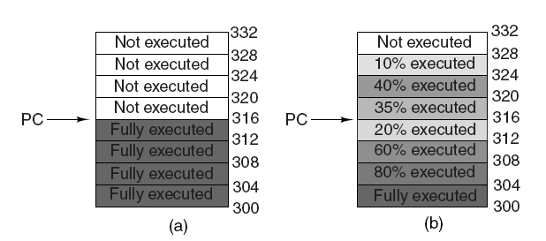
Precise and Imprecise Interrupts (2)
(a) A precise interrupt. (b) An imprecise interrupt.
Tanenbaum, Modern Operating Systems 3 e, (c) 2008 Prentice-Hall, Inc. All rights reserved. 0-13-6006639

Slide 29
How to process an imprecise interrupt
With great difficulty
Either Need complicated hardware logic to re-start after interrupt (Pentium)
Or have complicated processing in the OS
Tanenbaum, Modern Operating Systems 3 e, (c) 2008 Prentice-Hall, Inc. All rights reserved. 0-13-6006639

Slide 30
I/O Software-Goals
Device independence - don’t have to specify the device when accessing the device
Uniform naming - name should not depend on device type
Error handling - do it as close to the device as possible (e.g. controller should be the first to fix error, followed by the driver)
OS needs to make I/O operations blocking (e.g. program blocks until data arrives on a read) because it is easy to write blocking ops
Tanenbaum, Modern Operating Systems 3 e, (c) 2008 Prentice-Hall, Inc. All rights reserved. 0-13-6006639

Slide 31
I/O Software-Goals
Buffering- e.g. when a packet arrives
Shared devices (disks) and un-shared devices (tapes) must be handled
Tanenbaum, Modern Operating Systems 3 e, (c) 2008 Prentice-Hall, Inc. All rights reserved. 0-13-6006639

Slide 32
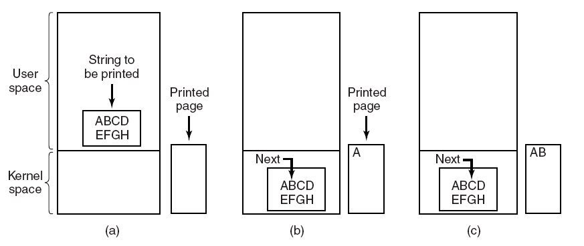
Programmed I/O
Steps in printing a string.
Tanenbaum, Modern Operating Systems 3 e, (c) 2008 Prentice-Hall, Inc. All rights reserved. 0-13-6006639

Slide 33
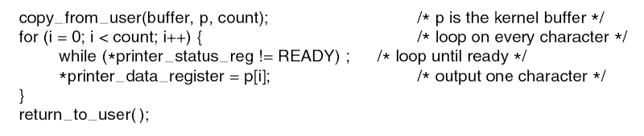
Programmed I/O
Send data one character at a time
Tanenbaum, Modern Operating Systems 3 e, (c) 2008 Prentice-Hall, Inc. All rights reserved. 0-13-6006639

Slide 34
Good vs Bad
The good: simple idea, OK if the CPU is not bothered too much
The bad: CPU is bothered too much
Tanenbaum, Modern Operating Systems 3 e, (c) 2008 Prentice-Hall, Inc. All rights reserved. 0-13-6006639

Slide 35
Interrupt Driven I/O
Idea: block process which requests I/O, schedule another process
Return to calling process when I/O is done
Printer generates interrupt when a character is printed
Keeps printing until the end of the string
Re-instantiate calling process
Tanenbaum, Modern Operating Systems 3 e, (c) 2008 Prentice-Hall, Inc. All rights reserved. 0-13-6006639

Slide 36
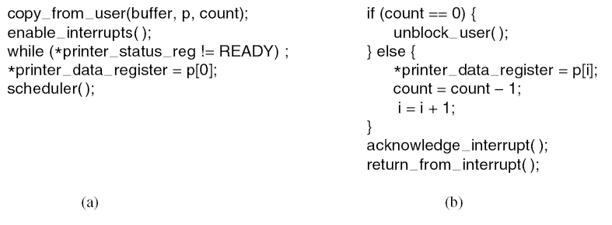
Interrupt-Driven I/O
. (a) Code executed at the time the print system call is made. (b) Interrupt service procedure for the printer.
Tanenbaum, Modern Operating Systems 3 e, (c) 2008 Prentice-Hall, Inc. All rights reserved. 0-13-6006639

Slide 37
DMA
Use DMA controller to send characters to printer instead of using the CPU
CPU is only interrupted when the buffer is printed instead of when each character is printed
DMA is worth it if
  (1) DMA controller can drive the device as fast as the CPU could drive it
  (2) there is enough data to make it worthwhile
Tanenbaum, Modern Operating Systems 3 e, (c) 2008 Prentice-Hall, Inc. All rights reserved. 0-13-6006639

Slide 38
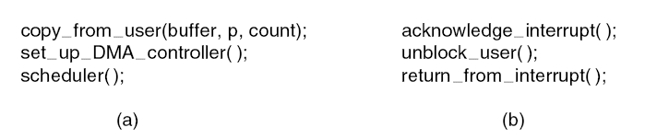
I/O Using DMA
. (a) Code executed when the print system call is made. (b) Interrupt service procedure.
Tanenbaum, Modern Operating Systems 3 e, (c) 2008 Prentice-Hall, Inc. All rights reserved. 0-13-6006639

Slide 39
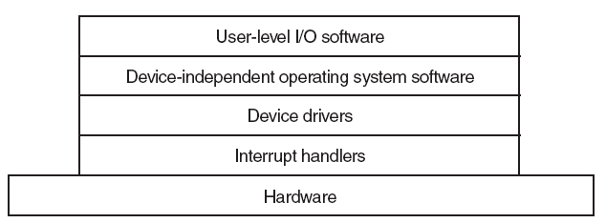
I/O Software Layers
Layers of the I/O software system.
Tanenbaum, Modern Operating Systems 3 e, (c) 2008 Prentice-Hall, Inc. All rights reserved. 0-13-6006639

Slide 40
Interrupt Handlers
The idea: driver starting the I/O blocks until interrupt happens when I/O finishes
Handler processes interrupt
Wakes up driver when processing is finished
Drivers are kernel processes with their very own
  Stacks
  PCs
  states
Tanenbaum, Modern Operating Systems 3 e, (c) 2008 Prentice-Hall, Inc. All rights reserved. 0-13-6006639

Slide 41
Interrupt processing details
Save registers not already saved by interrupt hardware.
Set up a context for the interrupt service procedure.
Set up a stack for the interrupt service procedure.
Acknowledge the interrupt controller. If there is no centralized interrupt controller, re-enable interrupts.
Copy the registers from where they were saved to the process table.
Tanenbaum, Modern Operating Systems 3 e, (c) 2008 Prentice-Hall, Inc. All rights reserved. 0-13-6006639

Slide 42
Interrupt processing details
Run the interrupt service procedure.
Choose which process to run next.
Set up the MMU context for the process to run next.
Load the new process’ registers, including its PSW.
Start running the new process.
Tanenbaum, Modern Operating Systems 3 e, (c) 2008 Prentice-Hall, Inc. All rights reserved. 0-13-6006639

Slide 43
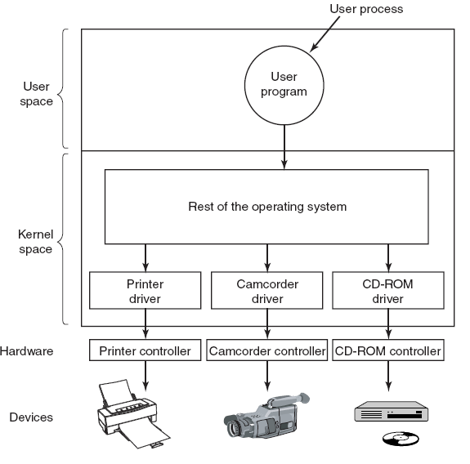
Device Drivers
Tanenbaum, Modern Operating Systems 3 e, (c) 2008 Prentice-Hall, Inc. All rights reserved. 0-13-6006639

Slide 44
Device Drivers-Act 1
Driver contains code specific to the device
Supplied by manufacturer
Installed in the kernel
User space might be better place
Why? Bad driver can mess up kernel
Need interface to OS
  block and character interfaces
  procedures which OS can call to invoke driver (e.g. read a block)
Tanenbaum, Modern Operating Systems 3 e, (c) 2008 Prentice-Hall, Inc. All rights reserved. 0-13-6006639

Slide 45
Device drivers Act 2
Checks input parameters for validity
Abstract to concrete translation (block number to cylinder, head, track, sector)
Check device status. Might have to start it.
Puts commands in device controller’s registers
Driver blocks itself until interrupt arrives
Might return data to caller
Does return status information
The end
Drivers should be re-entrant
OS adds devices when system (and therefore driver) is running
Tanenbaum, Modern Operating Systems 3 e, (c) 2008 Prentice-Hall, Inc. All rights reserved. 0-13-6006639

Slide 46
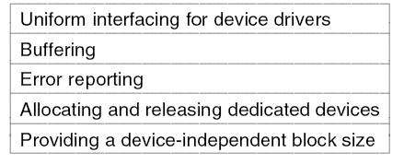
Device-Independent I/O Software
Tanenbaum, Modern Operating Systems 3 e, (c) 2008 Prentice-Hall, Inc. All rights reserved. 0-13-6006639

Slide 47
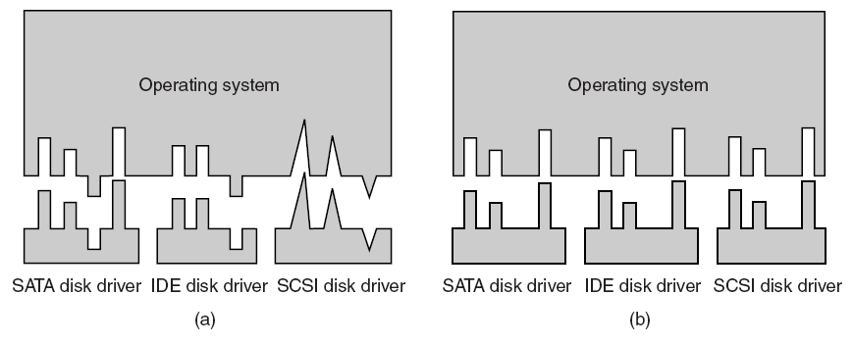
Why the OS needs a standard interface
Driver functions differ for different drivers
Kernel functions which each driver needs are different for different drivers
Too much work to have new interface for each new device type
Tanenbaum, Modern Operating Systems 3 e, (c) 2008 Prentice-Hall, Inc. All rights reserved. 0-13-6006639

Slide 48
Interface:Driver functions
OS defines functions for each class of devices which it MUST supply, e.g. read, write, turn on, turn off……..
Driver has a table of pointers to functions
OS just needs table address to call the functions
OS maps symbolic device names onto the right driver
Tanenbaum, Modern Operating Systems 3 e, (c) 2008 Prentice-Hall, Inc. All rights reserved. 0-13-6006639

Slide 49
Interface: Names and protection
OS maps symbolic device names onto the right driver
Unix: /dev/disk0 maps to an i-node which contains the major and minor device numbers for disk0
  Major device number locates driver, minor device number passes parameters (e.g. disk)
Protection: In Unix and Windows devices appear as named objects => can use file protection system
Tanenbaum, Modern Operating Systems 3 e, (c) 2008 Prentice-Hall, Inc. All rights reserved. 0-13-6006639

Slide 50
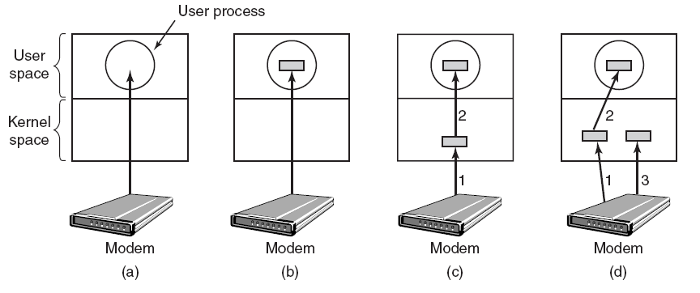
Buffering
(a) Unbuffered input. (b) Buffering in user space.
(c) Buffering in the kernel followed by copying to user space. (d) Double buffering in the kernel.
Tanenbaum, Modern Operating Systems 3 e, (c) 2008 Prentice-Hall, Inc. All rights reserved. 0-13-6006639

Slide 51
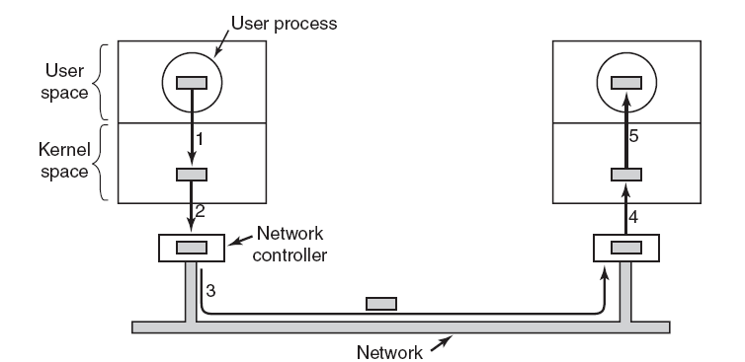
Buffering
Networking may involve many copies of a packet.
Tanenbaum, Modern Operating Systems 3 e, (c) 2008 Prentice-Hall, Inc. All rights reserved. 0-13-6006639

Slide 52
More Functions of Independent Software
Error reporting - programming errors (the user asks for the wrong thing), hardware problems (bad disk) are reported if they can’t be solved by the driver
Allocates and releases devices which can only be used by one user at a time (CD-ROM players)
  Queues requests or
  Lets open simply fail
Device independent block size-OS does not have to know the details of the devices
  E.g. combine sectors into blocks
Tanenbaum, Modern Operating Systems 3 e, (c) 2008 Prentice-Hall, Inc. All rights reserved. 0-13-6006639

Slide 53
User Space I/O Software
Library routines are involved with I/O- printf, scanf, write for example. These routines makes system calls
Spooling systems - keep track of device requests made by users.
Think printing.
  User generates file, puts it in a spooling directory.
  Daemon process monitors the directory, printing the user file
File transfers also use a spooling directory
Tanenbaum, Modern Operating Systems 3 e, (c) 2008 Prentice-Hall, Inc. All rights reserved. 0-13-6006639

Slide 54
Example Flow through layers
User wants to read a block, asks OS
Device independent software looks for block in cache
If not there, invokes device driver to request block from disk
Transfer finishes, interrupt is generated
User process is awakened and goes back to work
Tanenbaum, Modern Operating Systems 3 e, (c) 2008 Prentice-Hall, Inc. All rights reserved. 0-13-6006639

Slide 55
Disks
Magnetic (hard)
  Reads and writes are equally fast=> good for storing file systems
  Disk arrays are used for reliable storage (RAID)
Optical disks (CD-ROM, CD-Recordables, DVD) used for program distribution
Tanenbaum, Modern Operating Systems 3 e, (c) 2008 Prentice-Hall, Inc. All rights reserved. 0-13-6006639

Slide 56
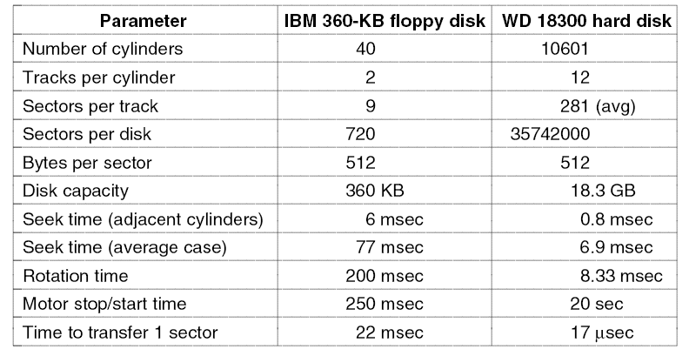
Floppy vs hard disk (20 years apart)
Seek time is 7x better, transfer rate is 1300 x better, capacity is 50,000 x better.
Tanenbaum, Modern Operating Systems 3 e, (c) 2008 Prentice-Hall, Inc. All rights reserved. 0-13-6006639

Slide 57
Disks-more stuff
Some disks have microcontrollers which do bad block re-mapping, track caching
Some are capable of doing more then one seek at a time, i.e. they can read on one disk while writing on another
Real disk geometry is different from geometry used by driver => controller has to re-map request for (cylinder, head,sector) onto actual disk
Disks are divided into zones, with fewer tracks on the inside, gradually progressing to more on the outside
Tanenbaum, Modern Operating Systems 3 e, (c) 2008 Prentice-Hall, Inc. All rights reserved. 0-13-6006639

Slide 58
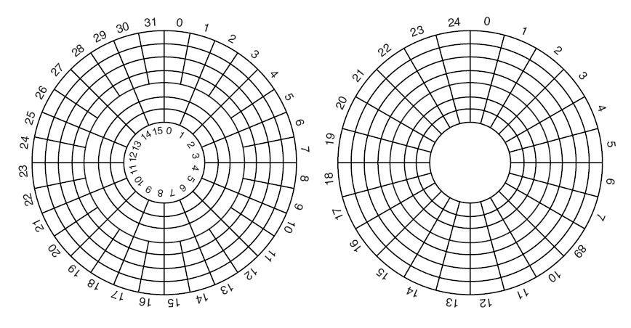
Disk Zones
(a) Physical geometry of a disk with two zones.
(b) A possible virtual geometry for this disk.
Tanenbaum, Modern Operating Systems 3 e, (c) 2008 Prentice-Hall, Inc. All rights reserved. 0-13-6006639

Slide 59
Redundant Array of Inexpensive Disks (RAID)
Parallel I/O to improve performance and reliability
vs SLED, Single Large Expensive Disk
Bunch of disks which appear like a single disk to the OS
SCSI disks often used-cheap, 7 disks per controller
SCSI is set of standards to connect CPU to peripherals
Different architectures-level 0 through level 7
Tanenbaum, Modern Operating Systems 3 e, (c) 2008 Prentice-Hall, Inc. All rights reserved. 0-13-6006639

Slide 60
Raid Levels
Raid level 0 uses strips of k sectors per strip.
  Consecutive strips are on different disks
  Write/read on consecutive strips in parallel
  Good for big enough requests
Raid level 1 duplicates the disks
  Writes are done twice, reads can use either disk
  Improves reliability
Level 2 works with individual words, spreading word + ecc over disks.
  Need to synchronize arms to get parallelism
Tanenbaum, Modern Operating Systems 3 e, (c) 2008 Prentice-Hall, Inc. All rights reserved. 0-13-6006639

Slide 61
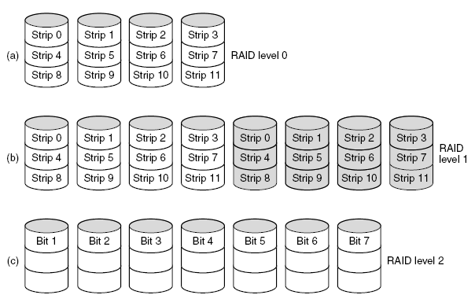
RAID Levels 0,1,2
Backup and parity drives are shown shaded.
Tanenbaum, Modern Operating Systems 3 e, (c) 2008 Prentice-Hall, Inc. All rights reserved. 0-13-6006639

Slide 62
Raid Levels 4 and 5
Raid level 3 works like level 2, except all parity bits go on a single drive
Raid 4,5 work with strips. Parity bits for strips go on separate drive (level 4) or several drives (level 5)
Tanenbaum, Modern Operating Systems 3 e, (c) 2008 Prentice-Hall, Inc. All rights reserved. 0-13-6006639

Slide 63
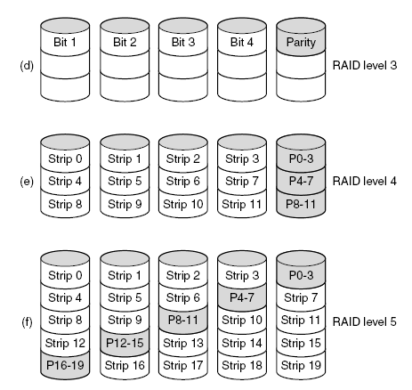
RAID
Backup and parity drives are shown shaded.
Tanenbaum, Modern Operating Systems 3 e, (c) 2008 Prentice-Hall, Inc. All rights reserved. 0-13-6006639

Slide 64
CD
Optical disks have higher density then mag disks
Used for distributing commercial software + reference works (books)
Cheap because of high production volume of music CDs
First used for playing music digitally
Tanenbaum, Modern Operating Systems 3 e, (c) 2008 Prentice-Hall, Inc. All rights reserved. 0-13-6006639

Slide 65
CD
Laser burns holes on a master (coated glass) disk
Mold is made with bumps where holes were
Resin poured into –has same pattern of holes as glass disk
Aluminum put on top of resin
Pits (depressions) and lands (unburned area) are arranged in spirals
Laser is used to read the pits and lands and convert them into bits (0 and 1)
Tanenbaum, Modern Operating Systems 3 e, (c) 2008 Prentice-Hall, Inc. All rights reserved. 0-13-6006639

Slide 66
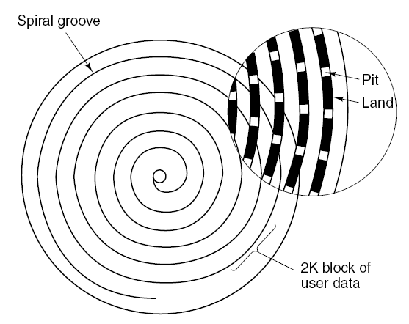
CD
Recording structure of a compact disc or CD-ROM.
Tanenbaum, Modern Operating Systems 3 e, (c) 2008 Prentice-Hall, Inc. All rights reserved. 0-13-6006639

Slide 67
CD-ROM
CD’s can be used to store data as well as audio
Enter the CD-ROM
Needed to improve the error-correcting ability of the CD
Encode each byte (8 bits) in a 14 bit symbol with 6 bits of ECC
42 symbols form a frame
Group 98 frames into a CD-ROM sector
Extra error-correcting code is attached to sector
Tanenbaum, Modern Operating Systems 3 e, (c) 2008 Prentice-Hall, Inc. All rights reserved. 0-13-6006639

Slide 68
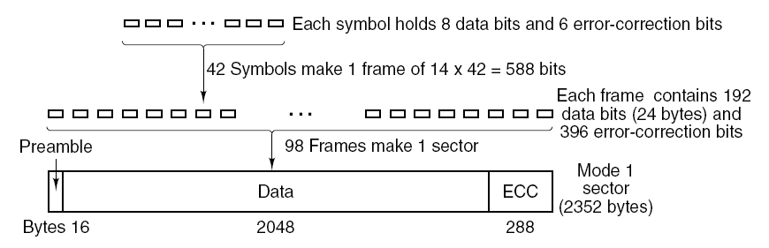
CD-ROMs Sector Layout
Sector
Tanenbaum, Modern Operating Systems 3 e, (c) 2008 Prentice-Hall, Inc. All rights reserved. 0-13-6006639

Slide 69
CD-ROM Performance
650 MB capacity
150 GB SCSI disk capacity
150 KB/sec in mode 1,
up to 5 MB/sec for 32x CD-ROM
Scsi-2 magnetic disk transfers at 10 MB/sec
Bottom line: CD drives can’t compare to scsi disk drives
Tanenbaum, Modern Operating Systems 3 e, (c) 2008 Prentice-Hall, Inc. All rights reserved. 0-13-6006639

Slide 70
CD-ROM
Added graphics, video, data
File system standards agreed upon
High Sierra for file names of 8 characters
Rock ridge for longer names and extensions
CD-ROM’s used for publishing games, movies, commercial software, reference works
Why? Cheap to manufacture and large capacity
Tanenbaum, Modern Operating Systems 3 e, (c) 2008 Prentice-Hall, Inc. All rights reserved. 0-13-6006639

Slide 71
CD-Recordable
Cheaper manufacturing process led to cheaper CD-ROM (CD-R)
Used as backup to disk drives
Small companies can use to make masters which they give to high volume plants to reproduce
Tanenbaum, Modern Operating Systems 3 e, (c) 2008 Prentice-Hall, Inc. All rights reserved. 0-13-6006639

Slide 72
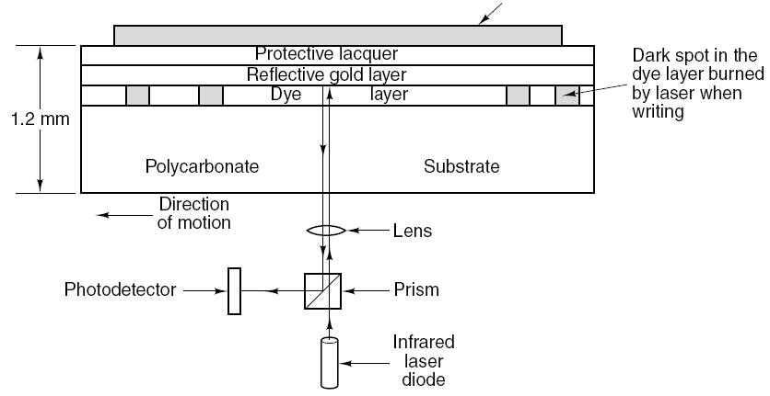
CD-Recordables
Cross section of a CD-R disk and laser. A silver
CD-ROM has similar structure, except without dye layer and with pitted aluminum layer instead of gold layer.
Tanenbaum, Modern Operating Systems 3 e, (c) 2008 Prentice-Hall, Inc. All rights reserved. 0-13-6006639

Slide 73
DVD (Digital Versatile Disk)
DVD use same design as CD with a few improvements
Smaller pits
(0.4 microns versus 0.8 microns for CDs).
A tighter spiral
(0.74 microns between tracks versus 1.6 microns for CDs).
A red laser
(at 0.65 microns versus 0.78 microns for CDs).
Tanenbaum, Modern Operating Systems 3 e, (c) 2008 Prentice-Hall, Inc. All rights reserved. 0-13-6006639

Slide 74
DVD (Digital Versatile Disk)
This led to much bigger capacity ~ 5 Gbyte (seven fold increase in capacity)
Can put a standard movie on the DVD (133 minutes)
Hollywood wants more movies on the same disk, so have 4 formats
Tanenbaum, Modern Operating Systems 3 e, (c) 2008 Prentice-Hall, Inc. All rights reserved. 0-13-6006639

Slide 75
DVD
DVD Formats
Single-sided, single-layer (4.7 GB).
Single-sided, dual-layer (8.5 GB).
Double-sided, single-layer (9.4 GB).
Double-sided, dual-layer (17 GB).
Tanenbaum, Modern Operating Systems 3 e, (c) 2008 Prentice-Hall, Inc. All rights reserved. 0-13-6006639

Slide 76
DVD: next generation
Blu-ray
HD
Computer industry and Hollywood have not agreed on formats yet!!
Tanenbaum, Modern Operating Systems 3 e, (c) 2008 Prentice-Hall, Inc. All rights reserved. 0-13-6006639

Slide 77
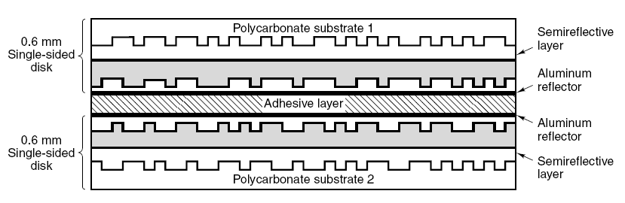
DVD
A double-sided, dual-layer DVD disk.
Tanenbaum, Modern Operating Systems 3 e, (c) 2008 Prentice-Hall, Inc. All rights reserved. 0-13-6006639

Slide 78
Hard Disk Formatting
Low level format-software lays down tracks and sectors on empty disk (picture next slide)
High level format is done next-partitions
Tanenbaum, Modern Operating Systems 3 e, (c) 2008 Prentice-Hall, Inc. All rights reserved. 0-13-6006639

Slide 79
Sector Format
512 bit sectors standard
Preamble contains address of sector, cylinder number
ECC for recovery from errors
Tanenbaum, Modern Operating Systems 3 e, (c) 2008 Prentice-Hall, Inc. All rights reserved. 0-13-6006639

Slide 80
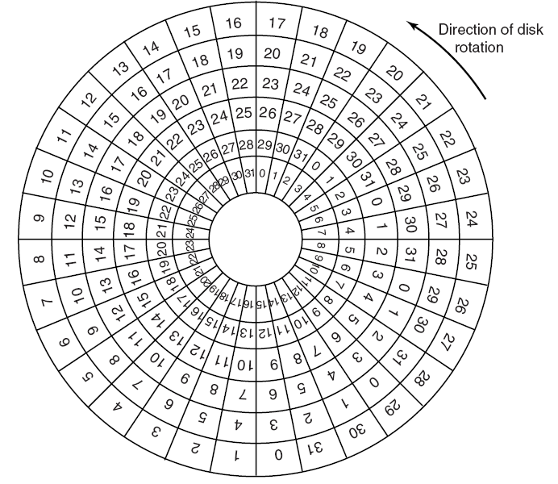
Cylinder Skew
Offset sector from one track to next one in order to get consecutive sectors
Tanenbaum, Modern Operating Systems 3 e, (c) 2008 Prentice-Hall, Inc. All rights reserved. 0-13-6006639

Slide 81
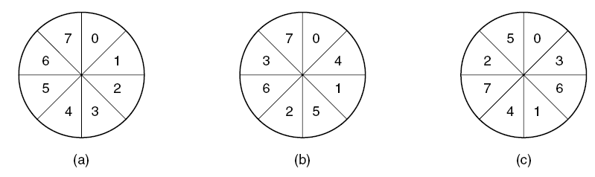
Interleaved sectors
Copying to a buffer takes time; could wait a disk rotation before head reads next sector. So interleave sectors to avoid this (b,c)
Tanenbaum, Modern Operating Systems 3 e, (c) 2008 Prentice-Hall, Inc. All rights reserved. 0-13-6006639

Slide 82
High level format
Partitions-for more then one OS on same disk
Pentium-sector 0 has master boot record with partition table and code for boot block
Pentium has 4 partitions-can have both Windows and Unix
In order to be able to boot, one sector has to be marked as active
Tanenbaum, Modern Operating Systems 3 e, (c) 2008 Prentice-Hall, Inc. All rights reserved. 0-13-6006639

Slide 83
High level format for each partition
master boot record in sector 0
boot block program
free storage admin (bitmap or free list)
root directory
empty file system
indicates which file system is in the partition (in the partition table)
Tanenbaum, Modern Operating Systems 3 e, (c) 2008 Prentice-Hall, Inc. All rights reserved. 0-13-6006639

Slide 84
Power goes on
BIOS reads in master boot record
Boot program checks which partition is active
Reads in boot sector from active partition
Boot sector loads bigger boot program which looks for the OS kernel in the file system
OS kernel is loaded and executed
Tanenbaum, Modern Operating Systems 3 e, (c) 2008 Prentice-Hall, Inc. All rights reserved. 0-13-6006639

Slide 85
Disk Arm Scheduling Algorithms
Read/write time factors
Seek time (the time to move the arm to the proper cylinder).
Rotational delay (the time for the proper sector to rotate under the head).
Actual data transfer time.
Tanenbaum, Modern Operating Systems 3 e, (c) 2008 Prentice-Hall, Inc. All rights reserved. 0-13-6006639

Slide 86
Disk Arm Scheduling Algorithms
Driver keeps list of requests (cylinder number, time of request)
Try to optimize the seek time
FCFS is easy to implement, but optimizes nothing
Tanenbaum, Modern Operating Systems 3 e, (c) 2008 Prentice-Hall, Inc. All rights reserved. 0-13-6006639

Slide 87
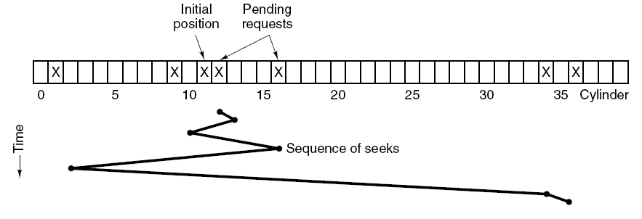
SSF (Shortest Seek Time First)
While head is on cylinder 11, requests for 1,36,16,34,9,12 come in
FCFS would result in 111 cylinders
SSF would require 1,3,7,15,33,2 movements for a total of 61 cylinders
Tanenbaum, Modern Operating Systems 3 e, (c) 2008 Prentice-Hall, Inc. All rights reserved. 0-13-6006639

Slide 88
Elevator algorithm
It is a greedy algorithm-the head could get stuck in one part of the disk if the usage was heavy
Elevator-keep going in one direction until there are no requests in that direction, then reverse direction
Real elevators sometimes use this algorithm
Variation on a theme-first go one way, then go the other
Tanenbaum, Modern Operating Systems 3 e, (c) 2008 Prentice-Hall, Inc. All rights reserved. 0-13-6006639

Slide 89
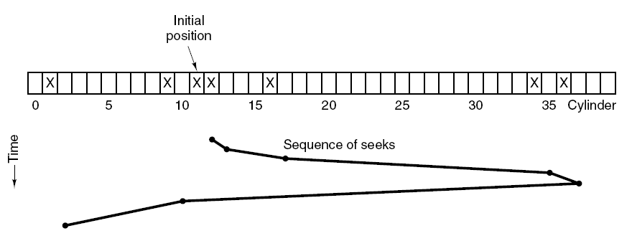
The Elevator
Uses 60 cylinders, a bit better
Tanenbaum, Modern Operating Systems 3 e, (c) 2008 Prentice-Hall, Inc. All rights reserved. 0-13-6006639

Slide 90
Disk Controller Cache
Disk controllers have their own cache
Cache is separate from the OS cache
OS caches blocks independently of where they are located on the disk
Controller caches blocks which were easy to read but which were not necessarily requested
Tanenbaum, Modern Operating Systems 3 e, (c) 2008 Prentice-Hall, Inc. All rights reserved. 0-13-6006639

Slide 91
Bad Sectors-the controller approach
Manufacturing defect-that which was written does not correspond to that which is read (back)
Controller or OS deals with bad sectors
If controller deals with them the factory provides a list of bad blocks and controller remaps good spares in place of bad blocks
Substitution can be done when the disk is in use-controller “notices” that block is bad and substitutes
Tanenbaum, Modern Operating Systems 3 e, (c) 2008 Prentice-Hall, Inc. All rights reserved. 0-13-6006639

Slide 92
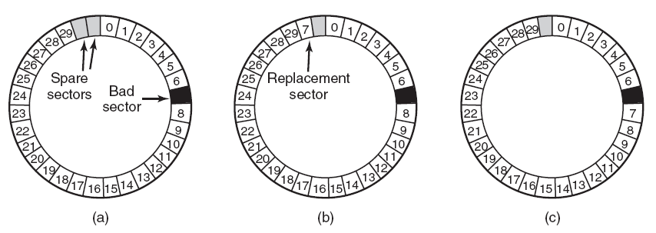
Error Handling
(a) A disk track with a bad sector.
(b) Substituting a spare for the bad sector.
(c) Shifting all the sectors to bypass the bad one.
Tanenbaum, Modern Operating Systems 3 e, (c) 2008 Prentice-Hall, Inc. All rights reserved. 0-13-6006639

Slide 93
Bad Sectors-the OS approach
Gets messy if the OS has to do it
OS needs lots of information-which blocks are bad or has to test blocks itself
Tanenbaum, Modern Operating Systems 3 e, (c) 2008 Prentice-Hall, Inc. All rights reserved. 0-13-6006639

Slide 94
Stable Storage
RAIDS can protect against sectors going bad
Can’t protect against write operations spitting out garbage or crashes during writes
Stable storage: either correct data is laid down or old data remains in place
Necessary for some apps-data can’t be lost or go bad
Tanenbaum, Modern Operating Systems 3 e, (c) 2008 Prentice-Hall, Inc. All rights reserved. 0-13-6006639

Slide 95
Assumptions
Can detect a bad write on subsequent reads via ECC
Probability of having bad data in sector on two different disks is negligible
If CPU fails, it stops along with any write in progress at the time. Bad data can be detected later via ECC during read op
Tanenbaum, Modern Operating Systems 3 e, (c) 2008 Prentice-Hall, Inc. All rights reserved. 0-13-6006639

Slide 96
The idea and the operations
Use 2 identical disks-do the same thing to both disks
Use 3 operations
Stable write-first write, then read back and compare. If they are the same write to second disk. If write fails, try up to n times to get it to succeed. After n failures keep using spare sectors until it succeeds. Then go to disk 2.
Tanenbaum, Modern Operating Systems 3 e, (c) 2008 Prentice-Hall, Inc. All rights reserved. 0-13-6006639

Slide 97
The idea and the OPS
Stable read-read from disk 1 n times until get a good ECC, otherwise read from disk 2 (assumption that probability of both sectors being bad is negligible)
Crash recovery-read both copies of blocks and compare them. If one block has an ECC error, overwrite it with the good block. If both pass the ECC test, then pick either
Tanenbaum, Modern Operating Systems 3 e, (c) 2008 Prentice-Hall, Inc. All rights reserved. 0-13-6006639

Slide 98
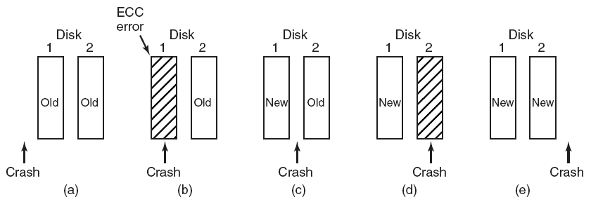
CPU Crashes
(a)Crash happens before write (b) crash happens during write to 1
(c)crash happens after 1 but before 2 (d) during 2, after 1 (e) both are the same
Tanenbaum, Modern Operating Systems 3 e, (c) 2008 Prentice-Hall, Inc. All rights reserved. 0-13-6006639

